Slide 1
Review and Improvements
Proof of Fundamental Theorem of the Local Theory of Curves
Beijing 101 Middle School: Yuanchenxi Gao
Shenzhen Yaohua Experimental School: Gangrong Wu
2023.1.29

Slide 2
Construction of Frenet Formulas
1. The curve is parametrized by the arc length s
Frenet formulas:
2. Define t(s), n(s), b(s):
Figure1: Frenet trihedron
Kaixin, W. Fundamental Theorem of The Local Theory of Curves.

Slide 3
Proof of Existense and Uniqueness of Contraction Mapping Theorem
A has unique fixed point
.
There is a unique function
.
contraction mapping theorem
1. F is continuous.
2. F(t,x) is globally Lipschitz in second variable.
3. The definite integral of L(t) on [T₁,T₂] is finite.
for sufficient large m
proved by mathematical induction
Kaixin, W. Fundamental Theorem of The Local Theory of Curves.

Slide 4
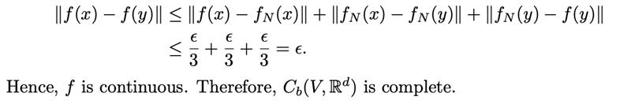
Proof of Completeness of
Figure2: graphical representation of the proof of continuity
Kaixin, W. Fundamental Theorem of The Local Theory of Curves.

Slide 5
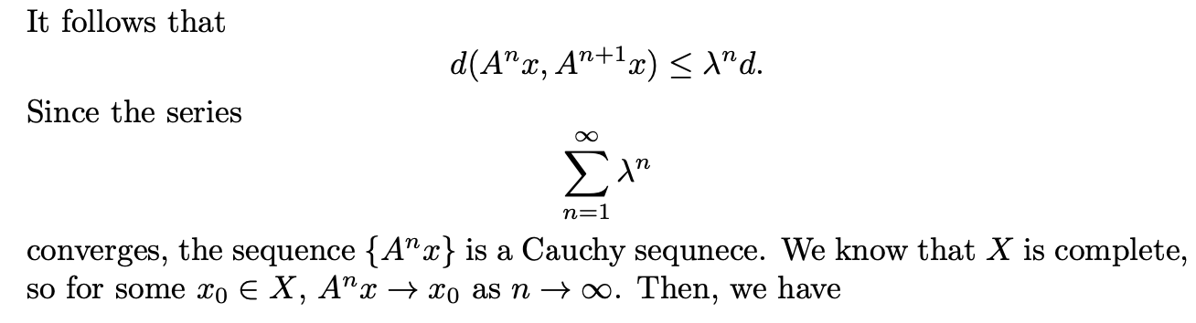
Improvements on the Proof of Contraction Mapping Theorem
sum of ratiometric sequence
Kaixin, W. Fundamental Theorem of The Local Theory of Curves.

Slide 6
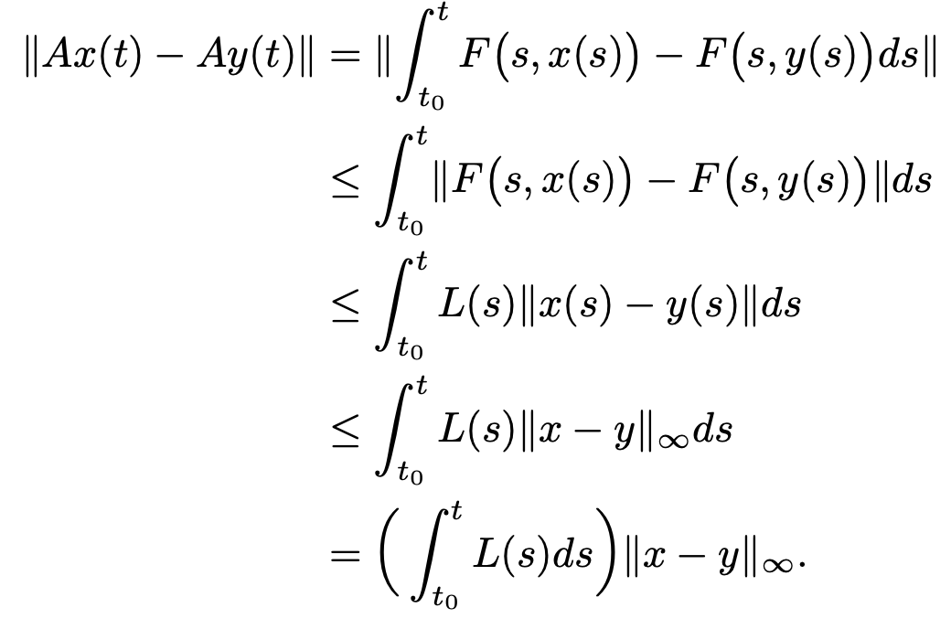
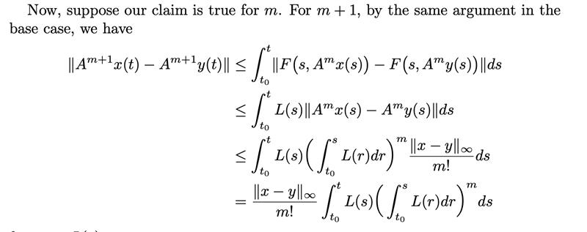
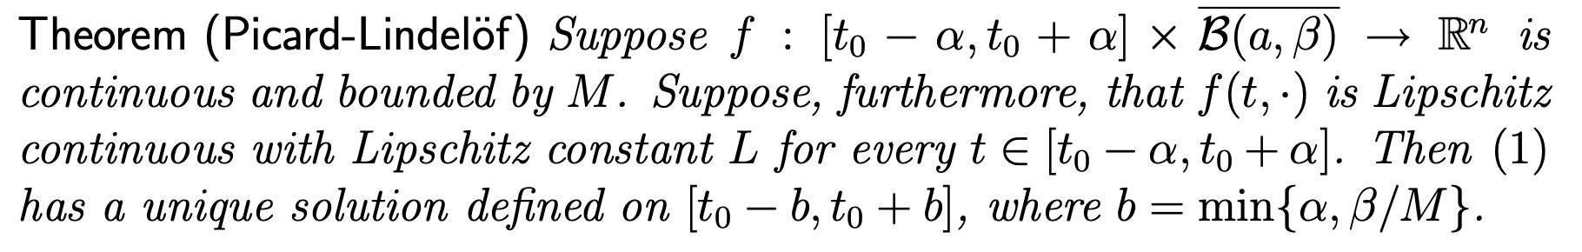
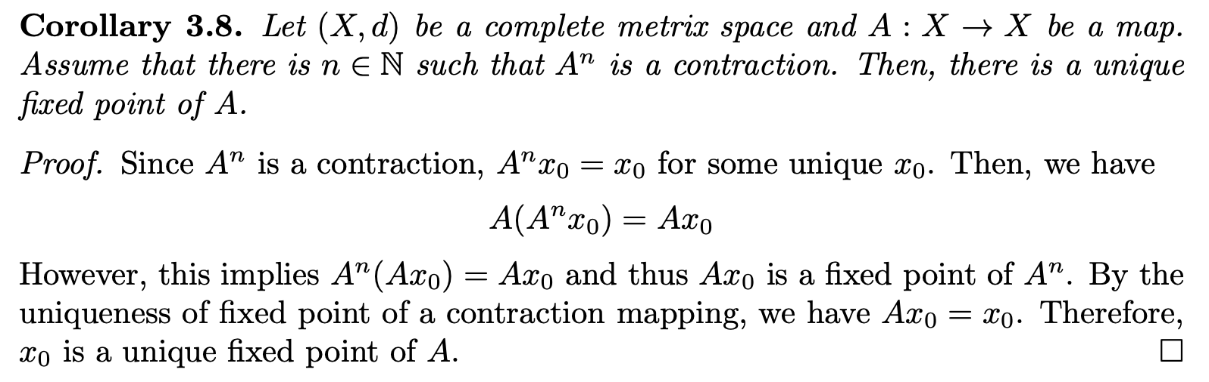
Another proof of Contraction Mapping A
Picard-Lindelöf Theorem
Mean Value Theorem
Kaixin, W. Fundamental Theorem of The Local Theory of Curves.

Slide 7
Reference
1. Kaixin, W. Fundamental Theorem of The Local Theory of Curves.
2. Picard-Lindelöf Theorem; 1999;
‌

Slide 8
请老师批评指正

